Slide 1
Digital Portfolio
STUDENT NAME: Jayant R
REGISTER NO: 2426K0018
NMID: 263651678335EC29F824737E0405FAE3
DEPARTMENT: Computer Technology
COLLEGE: Sri Krishna Adithya College of Arts and Science / Bharathiyar University

Slide 2
PROJECT TITLE
Interactive Student Portfolio Website using Frontend Web Development

Slide 3

AGENDA
Problem Statement
Project Overview
End Users
Tools and Technologies
Portfolio design and Layout
Features and Functionality
Results and Screenshots
Conclusion
Github Link

Slide 4

PROBLEM STATEMENT
Many students lack a professional online presence.
Traditional resumes are static and do not showcase projects, skills, and achievements interactively.
Need for a personal portfolio website where:
- Students can highlight their skills & projects.
- Recruiters/teachers can easily access student information.
- Acts as a digital resume

Slide 5
PROJECT OVERVIEW
A personal portfolio website created using HTML, CSS, and JavaScript.
Showcases my:
- Personal introduction (About Me)
- Skills
- Projects (Java, Web Development, etc.)
- Contact Information
Responsive and user-friendly design.
Developed as part of Naan Mudhalvan Project.

Slide 6

WHO ARE THE END USERS?
Students → to present their profile and achievements.
Recruiters/Employers → quick overview of skills & projects.
College Faculty → to evaluate project work.
Peers & Community → to collaborate and connect.

Slide 7
TOOLS AND TECHNIQUES
Languages Used:
- HTML5 (structure)
- CSS3 (styling, layout)
- JavaScript (interactivity)
IDE/Editor: Visual Studio Code
Extensions Used: Live Server, Prettier, HTML-CSS Support
Version Control: GitHub (for hosting code)
Optional Libraries: Font Awesome (icons), Google Fonts

Slide 8
POTFOLIO DESIGN AND LAYOUT
Sections in Website:
- Home (Welcome + Profile Photo + Social Links)
- About Me (Introduction, Career Goals, Naan Mudhalvan context)
- Skills (Technical skills like HTML, CSS, JS, Java, Python, SQL)
- Projects (Java & Web Projects)
- Contact Form (for direct communication)
8

Slide 9
Design Features:
- Modern UI with gradients & hover effects
- Responsive layout (works on mobile & desktop)
- Simple navigation bar (sticky)

Slide 10
FEATURES AND FUNCTIONALITY
Responsive Home Page with Photo + Social Media Links.
About Section with Naan Mudhalvan Course details.
Skills Section with hover highlights.
Projects Section:
- Portfolio Website
- Student Result System (Web App)
- Tic Tac Toe Game (Java)
- Note-Making App (Java Swing)
Contact Form → allows visitors to send a message.

Slide 11

RESULTS AND SCREENSHOTS
Homepage with profile picture
11

Slide 12
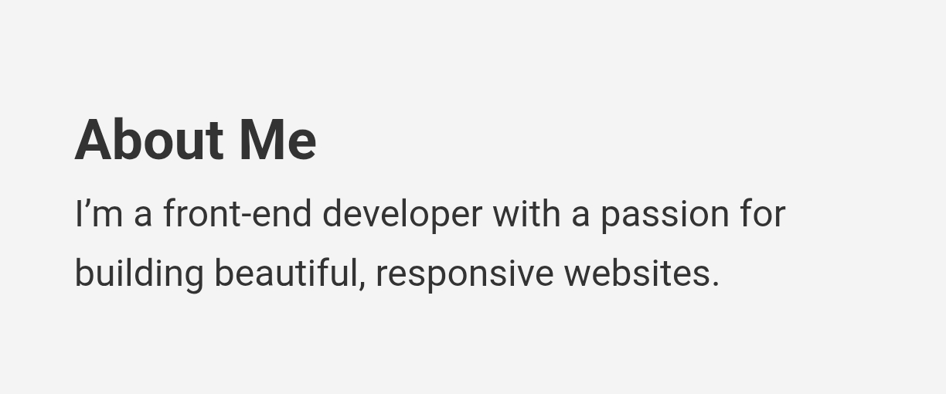
About Section

Slide 13
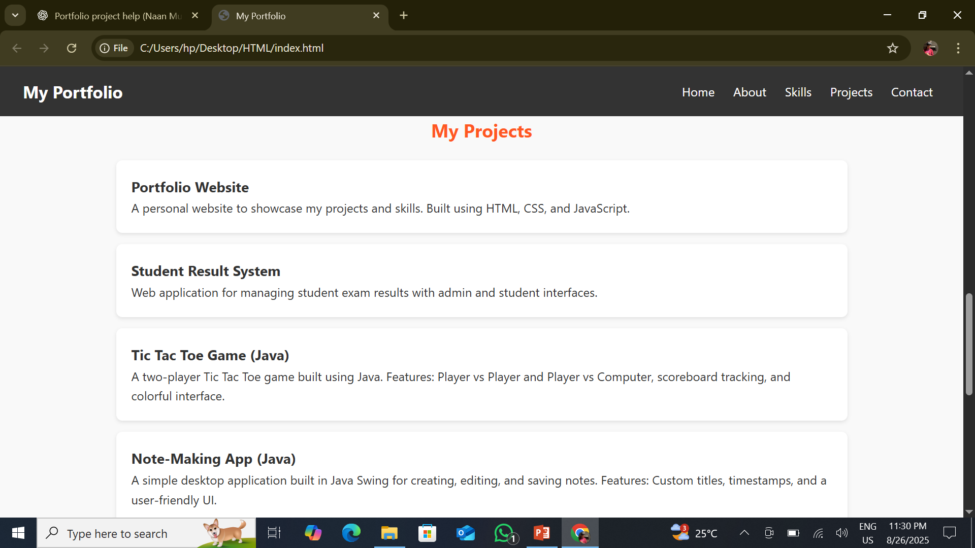
Projects Section

Slide 14
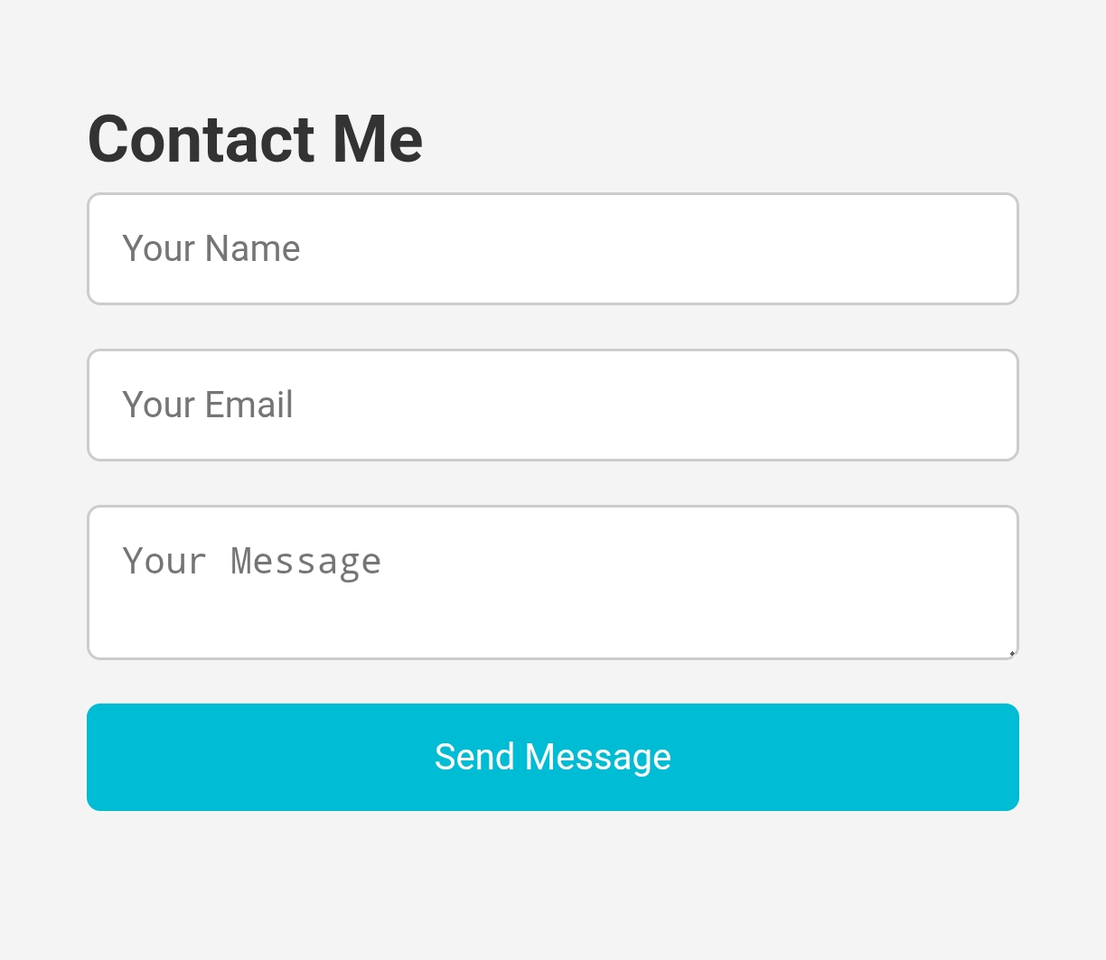
Contact Form

Slide 15
CONCLUSION
Successfully developed a Portfolio Website for self-branding.
Learned fundamentals of web development (HTML, CSS, JavaScript).
Integrated academic & personal projects for better career opportunities.
Acts as a digital resume + project showcase.
Future Scope:
- Host website online using GitHub Pages
- Add more advanced features (animations, dark mode, blogs)
15

Slide 16
Github Link
https://github.com/24bsct117jayantr-ai/Project.git

